Slide 1
Basic Structures of Computers
COMPUTER ORGANIZATION AND ARCHITECTURE
Course Code: 12CS35

Slide 2
Functional units
Basic Operational Concepts
Bus Structures
Performance
Processor clock
Basic performance equation
Pipelining and Superscalar operation
Clock rate
Performance measurement- SPEC, CISC and RISC models.

Slide 3
Difference between Computer organization and Computer architecture
Computer organization Deals with all physical components of computer systems that interacts with each other to perform various functionalities
The lower level of computer organization is known as micro-architecture which is more detailed and concrete.
Examples of Organizational attributes includes Hardware details transparent to the programmer such as control signal and peripheral.
Computer architecture
Refers as a set of attributes of a system as seen by programmer
Examples of the Architectural attributes include the instruction set, the no of bits used to represent the data types, Input Output mechanism and technique for addressing memories.

Slide 4
Definition of Computer:
A Digital computer is a fast electronic calculating machine that accepts digitized input information, processes it according to a list of internally stored instructions and produces the resulting output information.
List of Instructions: is called a computer program
Internally stored: Program that is stored in memory.
Data: Data are numbers and encoded characters that are used as operands by the instructions.

Slide 5
Functional units
Basic Functional units of a computer are:
Input Unit
Output Unit
Memory
Arithmetic Unit
Control Unit
Program
&
Data
Input Unit
Output
Unit
Memory
Result
Control Unit
Central
Processing
Unit
Arithmetic
Logic Unit

Slide 6
Input Unit
Computer accept coded information through input units, which read the data. Some of the devices are –
Keyboard
joysticks
trackballs
mouse
Audio input through Microphones

Slide 7
Memory Unit
The function of memory unit is to store programs and data.
Memory is classified based on three factors –
Speed
Cost
Size
The figure shows the hierarchy of memory -

Slide 8
Memory Speed, Cost and Size
Processor
Increasing
Registers
Increasing
Increasing
size
speed
cost per bit
Primary Cache
L1
Secondary cache
L2
Main
memory
Magnetic disk
memory

Slide 9
Arithmetic Logic Unit (ALU)
Most computer operations are executed in the arithmetic and logic unit (ALU)
The arithmetic operations are performed by bringing the operands from the memory or I/O device into fast registers of the processor, from where the operands are moved to the ALU to perform the required operation.
Registers can store one word and are much faster than the cache memory.
Output Unit:
Output unit function is to send processed results to the outside world. Some of the devices are – monitor, printer etc.

Slide 10
Control Unit
Control unit is the nerve center that sends control signals to other units and senses their states. The signals sent are –
The actual timing signals that govern the transfers are generated.
Data transfers between the processor and the memory are controlled.
Data transfers between the processor and I/O are controlled.
Program fetch and decoding is controlled.

Slide 11
Operation of a computer
The computer accepts information in the form of programs and data through an input unit and stores it in the memory.
Information stored in the memory is fetched, under program control, into an execution unit (which has ALU), where the data is processed.
The processed information leaves the computer through an output unit.
All activities inside the machine are directed by the control unit.

Slide 12
Review
Activity in a computer is governed by instructions.
To perform a task, an appropriate program consisting of a list of instructions is stored in the memory.
Individual instructions are brought from the memory into the processor, which executes the specified operations.
Data to be used as operands are also stored in the memory.

Slide 13
Data Storage and Addressing
Numbers and character operands, as well as instructions are stored in the memory of a computer.
The memory is organized so that a group of n bits can be stored or retrieved in a single, basic operation. Each group of n bits is referred to as a word of information and n is called the word length. n bits
First word
Second word

Slide 14
There is two ways that byte addresses can be assigned across words.
Big-endian assignment
Little-endian assignment.
Word Byte Address Byte Address
Add
Big-endian assignment Little-endian assignment
Byte and word addressing
0 | 0 | 1 | 2 | 3
4 | 4 | 5 | 6 | 7
 | :
2²-4 | 2^{k}-4 | 2^{k}-3 | 2^{k}-2 | 2^{k}-1
0 | 3 | 2 | 1 | 0
4 | 7 | 6 | 5 | 4
 | :
2²-4 | 2^{k}-1 | 2^{k}-2 | 2^{k}-3 | 2^{k}-4

Slide 15
A Typical Instruction
Add LOCA, R0
Add the operand at memory location LOCA to the operand in a register R0 in the processor.
Place the sum into register R0.
The original contents of LOCA are preserved.
The original contents of R0 is overwritten.
Instruction is fetched from the memory into the processor – the operand at LOCA is fetched and added to the contents of R0 – the resulting sum is stored in register R0.

Slide 16
Separate Memory Access and ALU Operation
Load LOCA, R1
Add R1, R0
Whose contents will be overwritten?
The contents of R0 is overwritten.
Explanation: Here the data from memory location LOCA is brought to R1.
The contents of R1 is added to R0.
The result is stored back into to R0. (Note: The old contents of R0 is replaced by the sum in R0)

Slide 17
Connection Between the Processor and the Memory
Memory
MAR
MDR
Control
PC
R₀
R₁
Processor
IR
R_{n-1}
ALU
n general purpose registers
Connections between the processor and the memory.

Slide 18
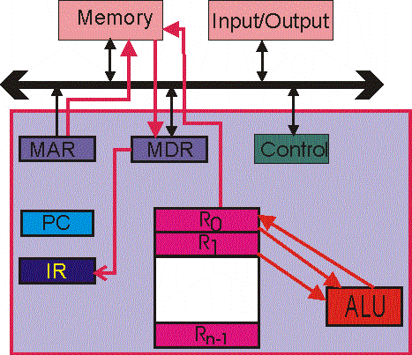

Slide 19
Registers
Instruction register (IR)
Program counter (PC)
General-purpose register (R₀ – R_{n-1})
Memory address register (MAR)
Memory data register (MDR)

Slide 20
Typical Operating Steps
Programs reside in the memory through input devices
PC is set to point to the first instruction
The contents of PC are transferred to MAR
A Read signal is sent to the memory
The first instruction is read out and loaded into MDR
The contents of MDR are transferred to IR
Decode and execute the instruction

Slide 21
Typical Operating Steps (Cont’)
Get operands for ALU
General-purpose register
Memory (address to MAR – Read – MDR to ALU)
Perform operation in ALU
Store the result back
To general-purpose register
To memory (address to MAR, result to MDR – Write)
During the execution, PC is incremented to the next instruction

Slide 22
Interrupt
Normal execution of programs may be preempted if some device requires urgent servicing.
The normal execution of the current program must be interrupted – the device raises an interrupt signal.
Interrupt-service routine is executed
Current system information backup and restore (PC, general-purpose registers, control information, specific information)

Slide 23
Bus Structures
There are many ways to connect different parts inside a computer together.
A group of lines that serves as a connecting path for several devices is called a bus.
The different busses in a system are
Address
Data
Control

Slide 24
Bus Structure
Single-bus
Input
Output
Memory
Processor
. Single-bus structure.

Slide 25
Bus Structure
CPU
Memory
…
Memory
I/O
…
I/O
Control
Address
Data

Slide 26
Speed Issue
Different devices have different transfer/ operate speed.
If the speed of bus is bounded by the slowest device connected to it, the efficiency will be very low.
How to solve this?
A common approach – use buffers.

Slide 27
Performance
The most important measure of a computer is how quickly it can execute programs.
Three factors affect performance:
Hardware design
Instruction set
Compiler

Slide 28
Performance
Processor time to execute a program depends on the hardware involved in the execution of individual machine instructions.
Main
Cache
memory
memory
Processor
Bus
Figure 1.5.
The processor cache.

Slide 29
Performance
The processor and a relatively small cache memory can be fabricated on a single integrated circuit chip.
Speed
Cost
Memory management

Slide 30
Processor Clock
Clock, clock cycle, and clock rate
Clock is the timing signal of a processor
Clock cycle is the regular time interval of a clock
Clock rate is the number of clock cycles per second.
Cycles per second is called herts (Hz).
Mega herts is Million instructions per second. (M Hz)
Giga herts is Billion instructions per second. (GHz)
The execution of each instruction is divided into several steps, each of which completes in one clock cycle.

Slide 31
Basic Performance Equation
T – processor time required to execute a program that has been prepared in high-level language
N – number of actual machine language instructions needed to complete the execution (note: loop)
S – average number of basic steps needed to execute one machine instruction. Each step completes in one clock cycle
R – clock rate
Note: these are not independent to each other
How to improve T?

Slide 32
Pipeline and Superscalar Operation
Instructions are not necessarily executed one after another.
The value of S doesn’t have to be the number of clock cycles to execute one instruction.
Pipelining – overlapping the execution of successive instructions.
Add R1, R2, R3
Superscalar operation – multiple instruction pipelines are implemented in the processor.
Goal – reduce S (could become <1!)

Slide 33
Clock Rate
Increase clock rate
Improve the integrated-circuit (IC) technology to make the circuits faster
Reduce the amount of processing done in one basic step (however, this may increase the number of basic steps needed)
Increases in R that are entirely caused by improvements in IC technology affect all aspects of the processor’s operation equally except the time to access the main memory.

Slide 34
CISC and RISC
Tradeoff between N and S
A key consideration is the use of pipelining
S is close to 1 even though the number of basic steps per instruction may be considerably larger
It is much easier to implement efficient pipelining in processor with simple instruction sets
Reduced Instruction Set Computers (RISC)
Complex Instruction Set Computers (CISC)

Slide 35
Compiler
A compiler translates a high-level language program into a sequence of machine instructions.
To reduce N, we need a suitable machine instruction set and a compiler that makes good use of it.
Goal – reduce N×S
A compiler may not be designed for a specific processor; however, a high-quality compiler is usually designed for, and with, a specific processor.

Slide 36
Performance Measurement
T is difficult to compute.
Measure computer performance using benchmark programs.
System Performance Evaluation Corporation (SPEC) selects and publishes representative application programs for different application domains, together with test results for many commercially available computers.
Compile and run (no simulation)
Reference computer

Slide 37
Where n is the number of programs in the suite.
Faster Clock=Shorter Running Time?
Faster steps do not necessarily mean shorter travel time

Slide 38

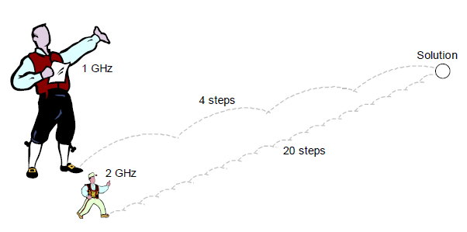
Less number of instruction for the same result
More number of instruction for the same result

Slide 39
Questions:
What is the basic difference between Computer Organization and Computer Architecture.
Write the functional block of a computer and explain briefly each part.
Write the functional blocks of a computer and explain the operation of a computer.
What are the factor on which the memory devices are classified? Explain.
Explain the characteristics of memory devices with reference to memory hierarchy.
What are the basic signals used by the control unit? What is it used for?
What are the different byte addresses that can be assigned across words?
Show how byte and word addressing is assigned?

Slide 40
List the steps needed to execute the machine instruction
Add LocA, R0
Assume that instruction itself is stored in the memory location INSTR and that this address is initially in PC register. Assume MAR, MDR, PC, IR, R0-R7 and ALU are available in the processor.
Repeat the problem 8 for the instruction
Add R1, R2, R3
What is an interrupt?
What is Interrupt Service Routine?
What is the procedure adopted by a processor when there is an interrupt?
What is a Bus? What are the different types of busses in a system?
What is the advantage and disadvantage of a bus system?
What are the factors that affect the performance of a system?
What is the difference between CISC and RISC processor?

